Slide 1
Automatic Wrapper Generation
Craig Knoblock
University of Southern California

Slide 2
Automatic Data Extraction
Learning wrappers for data extraction
  Users specifies the schema of the information source
    Single tuple
    Nested type
    List of tuples or nested types
  Labels data on several example HTML pages
    Tedious, especially for lists
Goal of Automatic Data Extraction is to eliminate user intervention
  Automatically generate wrappers to extract data from Web pages
  cf Information Extraction: Automatically extracts data from text

Slide 3
Overview
Methods for automatic wrapper generation and data extraction
  Grammar Induction approach
    Towards Automatic Data Extraction from Large Web Sites
  Website structure-based approach
    AutoFeed: An Unsupervised Learning System for Generating Webfeeds
Notes:
DOM-based:
Simile/Piggybank

Slide 4
Grammar Induction Approach
Pages automatically generated by scripts that encode results of db query into HTML
  Script = grammar
Given a set of pages generated by the same script
  Learn the grammar of the pages
    Wrapper induction step
  Use the grammar to parse the pages
    Data extraction step

Slide 5
Limitations
Learnable grammars
  Union-Free Regular Expressions (RoadRunner)
    Variety of schema structure: tuples (with optional attributes) and lists of (nested) tuples
    Does not efficiently handle disjunctions – pages with alternate presentations of the same attribute
  Context-free Grammars
    Limited learning ability
User needs to provide a set of pages of the same type

Slide 6
Website Structure-based Approach
Websites attempt to simplify user navigation and interaction with data by organizing how data is presented across the site
  Hierarchical organization
    List of results
    Detail pages …
  Machine learning methods take advantage of structure to extract data

Slide 7
RoadRunner: Towards Automatic Data Extraction from Large Web Sites by Crescenzi, Mecca, & Merialdo

Slide 8
RoadRunner Overview
Automatically generates a wrapper from large web pages
  Pages of the same class
  No dynamic content from javascript, ajax, etc
Infers source schema
  Supports nested structures and lists
  Extracts data from pages
Efficient approach to large, complex pages with regular structure
Notes:
“given a set of sample HTML pages belonging to the same class, find the nested type of the source dataset and extract the source dataset from which the
pages have been generated.”

Slide 9
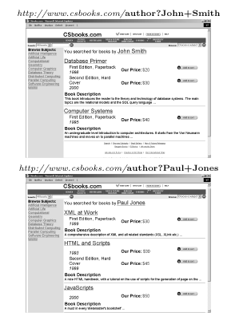
Example
Pages
Compares two pages at a time to find similarities and differences
Infers nested structure (schema) of page
Extracts fields

Slide 10
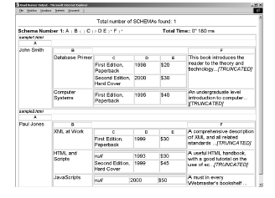
Extracted Result

Slide 11
Union-Free Regular Expression (UFRE)
Web page structure can be represented as Union-Free Regular Expression (UFRE)
  UFRE is Regular Expressions without disjunctions
  If a and b are UFRE, then the following are also UFREs
    a.b
    (a)+
    (a)?

Slide 12
Union-Free Regular Expression (UFRE)
Web page structure can be represented as Union-Free Regular Expression (UFRE)
  UFRE is Regular Expressions without disjunctions
  If a and b are UFRE, then the following are also UFREs
    a.b → string fields
    (a)+ → lists (possibly nested)
    (a)? → optional fields
  Strong assumption that usually holds

Slide 13
Approach
Given a set of example pages
Generate the Union-Free Regular Expression which contains example pages
Find the least upper bounds on the RE lattice to generate a wrapper in linear time
Reduces to finding the least upper bound on two UFREs

Slide 14
Matching/Mismatches
Given a set of pages of the same type
Take the first page to be the wrapper (UFRE)
Match each successive sample page against the wrapper
Mismatches result in generalizations of wrapper
  String mismatches
  Tag mismatches

Slide 15
Matching/Mismatches
Given a set of pages of the same type
Take the first page to be the wrapper (UFRE)
Match each successive sample page against the wrapper
Mismatches result in generalizations of wrapper
  String mismatches
    Discover fields
  Tag mismatches
    Discover optional fields
    Discover iterators

Slide 16
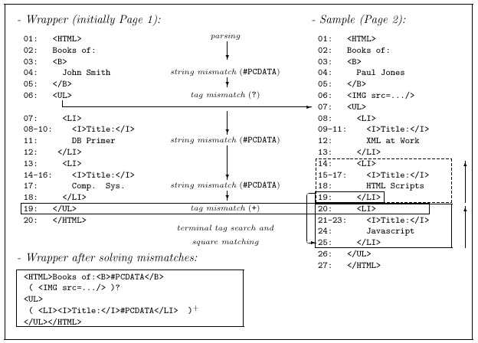
Example Matching
Notes:
Matching algorithm parses the sample using the wrapper. Mismatch happens when a token in the sample does not correspond to toke nin the wrapper.

Slide 17
String Mismatches: Discovering Fields
String mismatches are used to discover fields of the document
Wrapper is generalized by replacing
“John Smith” with #PCDATA
<HTML>Books of: <B>John Smith
→ <HTML> Books of: <B>#PCDATA

Slide 18
Example Matching

Slide 19
Tag Mismatches: Discovering Optionals
First check to see if mismatch is caused by an iterator (described next)
If not, could be an optional field in wrapper or sample
Cross search used to determine possible optionals
Image field determined to be optional:
  ( <img src=…/>)?

Slide 20
Example Matching
String Mismatch
String Mismatch

Slide 21
Tag Mismatches:
Discovering Iterators
Assume mismatch is caused by repeated elements in a list
  End of the list corresponds to last matching token: </LI>
  Beginning of list corresponds to one of the mismatched tokens: <LI> or </UL>
  These create possible “squares”
Match possible squares against earlier squares
Generalize the wrapper by finding all contiguous repeated occurrences:
  ( <LI><I>Title:</I>#PCDATA</LI> )+

Slide 22
Example Matching

Slide 23
Internal Mismatches
Generate internal mismatch while trying to match square against earlier squares on the same page
  Solving internal mismatches yield further refinements in the wrapper
    List of book editions
    <I>Special!</I>

Slide 24
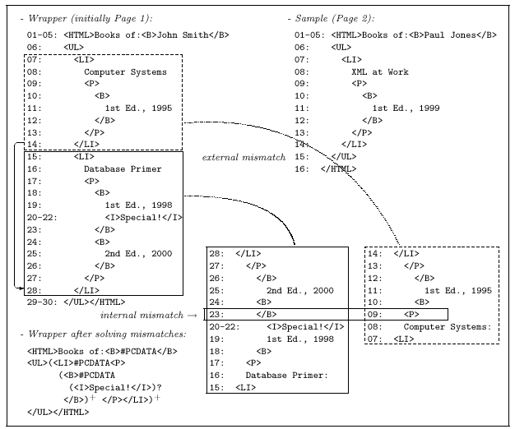
Recursive Example

Slide 25
Discussion
Assumptions:
  Pages are well-structured
  Structure can be modeled by UFRE (no disjunctions)
Search space for explaining mismatches is huge
  Uses a number of heuristics to prune space
    Limited backtracking
    Limit on number of choices to explore
    Patterns cannot be delimited by optionals
  Will result in pruning possible wrappers

Slide 26
AutoFeed: An Unsupervised Learning System for Generating Webfeeds

Slide 27
Relational Model of a Web Site
Homepage
0 AutoFeedWeather
StateList
0 0
0 1
States
0 California CA
1 Pennyslvania PA
CityList
0 0
0 1
0 2
1 3
1 4
CityWeather
0 Los Angeles 70
1 San Francisco 65
2 San Diego 75
3 Pittsburgh 50
4 Philadelphia 55
Sites are well structured to improve user experience
Generation: Given relational data, scripts generate web site, e.g., weather site
Extraction is opposite task: Given web site, find underlying relational data
Homepage
page-type
State
page-type
CityWeather
page-type

Slide 28
Chicken ‘n Egg Problem
Homepage
0 AutoFeedWeather
StateList
0 0
0 1
States
0 California CA
1 Pennyslvania PA
CityList
0 0
0 1
0 2
1 3
1 4
CityWeather
0 Los Angeles 70
1 San Francisco 65
2 San Diego 75
3 Pittsburgh 50
4 Philadelphia 55
If we could pick out a set of pages of the same class, we could learn their grammar and extract data
But how do we pick the right pages in the first place?
Homepage
page-type
State
page-type
CityWeather
page-type

Slide 29
Overview of Approach
Many types of structure within site
  Graph structure of site’s links
  URL naming scheme
  Content of pages
  HTML structure within page types, …
Experts focus on individual structures and output discoveries as hints
  Experts are heterogeneous
  Probabilistically combine experts (don’t have to be correct all the time)

Slide 30
Hints
Hints describe local structural similarities within pages or within data
Hints help find relational structure of the site
Simultaneously cluster pages and data using hints

Slide 31
Overview
Homepage
0 AutoFeedWeather
States
0 California CA
1 Pennyslvania PA
CityWeather
0 Los Angeles 70
1 San Francisco 65
2 San Diego 75
3 Pittsburgh 50
4 Philadelphia 55
Cluster
California
Pennsylvania
CA
PA
Convert
Experts
Los Angeles
San Franciso
San Diego
Pittsburgh
Philadelphia
70
65
75
50
55
Web Site
Page & Data
Hints
Page & Data
Clusters
Relational Tables

Slide 32
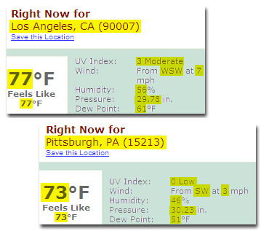
Page-level Experts
URL patterns give clues about site structure
  Similar pages have similar URLs, e.g.:
    http://www.bookpool.com/sm/0321349806
    http://www.bookpool.com/sm/0131118269
    http://www.bookpool.com/ss/L?pu=MN
Page templates
  Similar pages contain common sequences of substrings

Slide 33
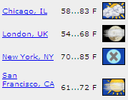
Data-level Experts
Page layout gives clues about relational structure
  Similar items aligned vertically or horizontally, e.g.:
  Coincidental alignment results in bad hints
List structure
  List rows are represented as repeating HTML structures
<TR>
<TR>
<TD>
<TD>
<TD>
<TD>
Los Angeles
85
Pittsburgh
65

Slide 34
Page and Data Similarity
Surface structure is often not helpful
  e.g., page with an empty list and one with a long list will be found not similar
Instead, use local structural similarities
  Experts output hints
  Structure represented as hints
  Clusters found probabilistically using hints
    Probabilistic representation gives flexible framework for combining possibly conflicting hints

Slide 35
Probabilistic Evaluation
Find clustering that maximizes probability of observing hints:
  P(clustering|hints) = P(hints|clustering)*P(clustering)/P(hints)

Slide 36
Clustering
Cluster pages and data
Page-clusters are parents of data-clusters
For example:
State Pages
City Pages
Cities
Temperatures
States
Abbrs
Los Angeles
San Franciso
San Diego
Pittsburgh
Philadelphia
70
65
75
50
55
California
Pennsylvania
CA
PA

Slide 37
Evaluation
A
B
A∩B
Precision = A∩B/A
Recall = A∩B/B
Retrieved
Results
Relevant
Results

Slide 38
Evaluation – another view
 | Actual Positive | Actual Negative
Retrieved Positive | TP | FP
Retrieved Negative | FN | TN
Precision = TP/(TP+FP)
Recall = TP/(TP+FN)

Slide 39
Experiments and Results
Domains
  Extract product name, manufacturer, price, etc., from online retail sites (Buy.com, CompUSA, etc.)
  Extract authors, titles, URLs, from journals (DMTCS, JAIR, etc.)
  Extract job id, position, location from job listings (50 Forbes 500 companies)
Good results
  Data extracted correctly from many of the sites
Some problems:
  Extracting larger fields, e.g. “Price: $19.95”
  Over-general & over-specific clusters
Field
RR
Ret.
Rel.
Precision
Recall
Retail
mfg
81
81
81
100%
100%
item no.
100
100
103
97%
97%
model no.
66
68
71
96%
93%
name
97
100
103
97%
94%
price
77
88
103
85%
75%
Journals
authors
1173
1197
1212
98%
97%
title
1173
1188
1212
99%
97%
URL
528
528
1212
100%
44%
Jobs
position
1391
1391
1453
100%
96%
req. id
1278
1278
1422
100%
90%
location
1302
1302
1445
100%
90%

Slide 40
AutoFeed Conclusions
Promising approach:
  Multiple experts for multiple structures
  Common language for collecting and combining evidence
Principle applicable to beyond web extraction
  Interpreting complex environments
Need to improve prototype system:
  More experts
  Better ways to combine evidence
    Confidence scores on hints
    Cannot-link hints

